Slide 1
Programming in Scratch
Lesson 2: Sequencing

Slide 2
Objectives
In this lesson, you will learn how to:
break down a complex problem
use sequencing to solve problems with multiple parts
identify patterns and construct code with as few blocks as possible.

Slide 3
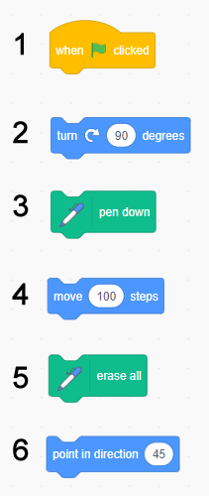
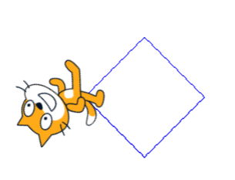
Sequencing blocks
Write the numbers of the blocks in the correct order to build a program that will create the following drawing:
HINT: You can use blocks more than once.

Slide 4

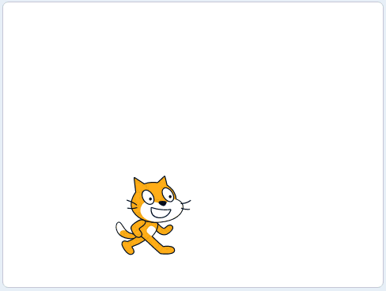
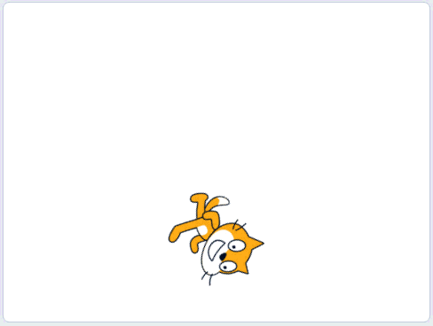
Activity 2.1: Drawing a hexagon
Example of finished solution
Example of extension activity 2

Slide 5
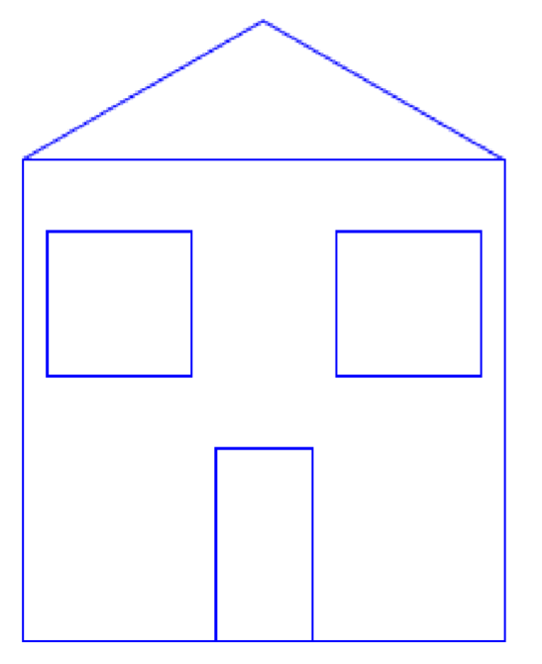
Solving complex problems
So far, the drawings you have created have involved just one shape.
More complex drawings are made up of different shapes.

Slide 6
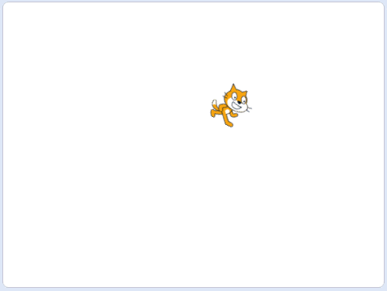
Activity 2.2: Creating a picture
Example of finished solution

Slide 7
Quiz 2

